Slide 1


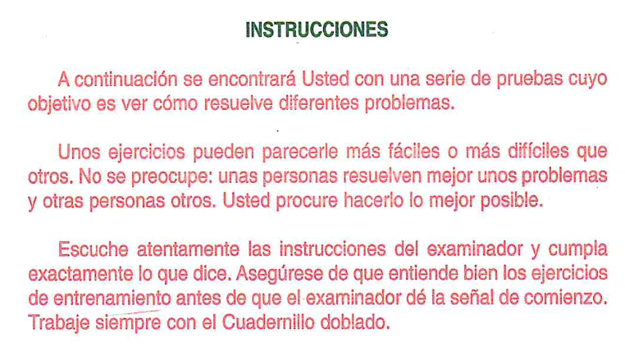
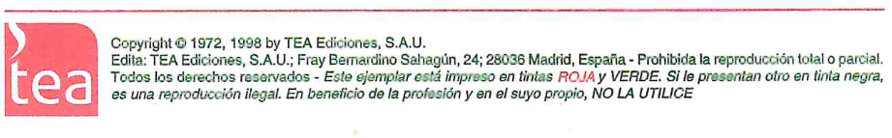
Cuenta
Desconexion

Slide 2
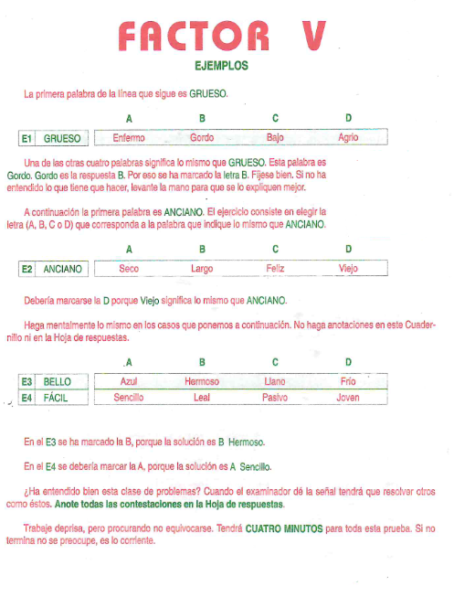
Cuenta
Desconexion
 |  | A | B | C | D
1 | Humedo |  |  |  |  | 1
2 | Rapido |  |  |  |  | 2
3 | Diario |  |  |  |  | 3
4 | Esplendido |  |  |  |  | 4
5 | Habitual |  |  |  |  | 5
6 | Fluido |  |  |  |  | 6
7 | Holgazan |  |  |  |  | 7

Slide 3
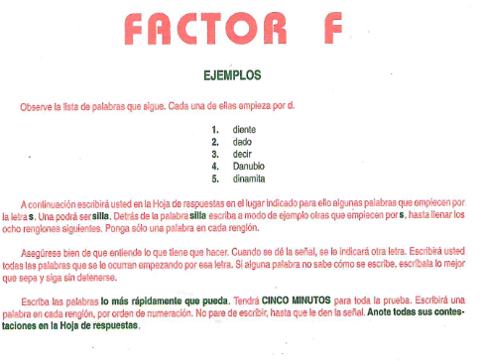
Cuenta
Desconexion

Slide 4
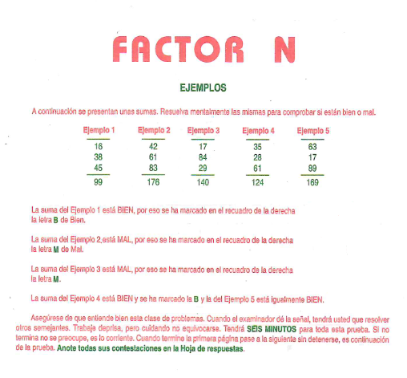
Cuenta
Desconexion
1 | 2 | 3 | 4 | 5 | 6 | 7 | 8 | 9 | 10
24
34
56
78
11 | 12 | 13 | 14 | 15 | 16 | 17 | 18 | 19 | 20

Slide 5
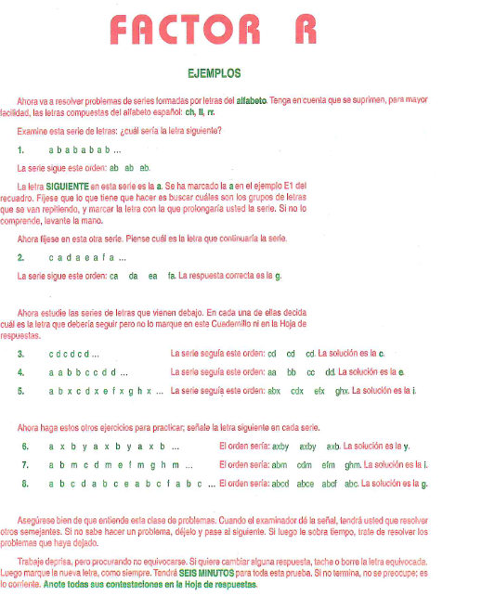
Cuenta
Desconexion
1 |  | 1
2 |  | 2
3 |  | 3
4 |  | 4
5 |  | 5
6 |  | 6
7 |  | 7
8 |  | 8
Finalizar

